Slide 1
Vectors & Matrices
Kuan Sao I
4th December 2019

Slide 2
Content
Vectors
Length
Dot product
Cross product
Matrices
Matrices operation
Matrices multiplication
Determinate
Inverse
Rank
Norm
Eigen vector
Types of Matrices
Notes:
https://www.mathsisfun.com/algebra/vectors-cross-product.html

Slide 3

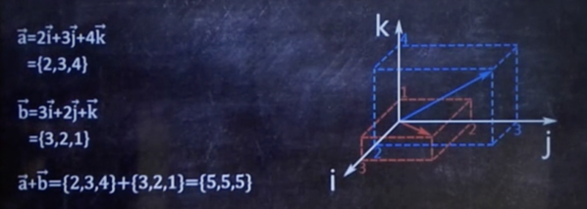
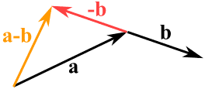
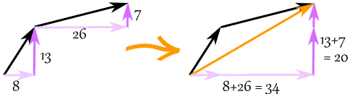
Vectors
A vector has magnitude (size) and direction.
Coordinate: (34,20)
Notes:
https://www.youtube.com/playlist?list=PLZHQObOWTQDPD3MizzM2xVFitgF8hE_ab
https://www.mathsisfun.com/algebra/vectors.html

Slide 4
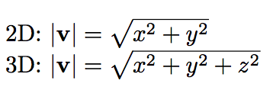
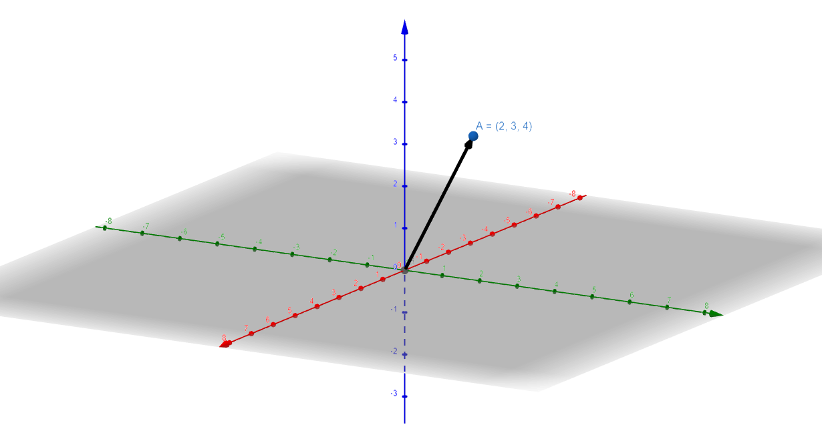

Length

Slide 5
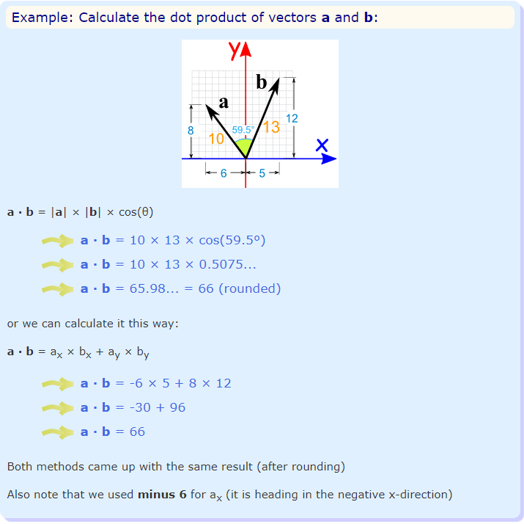
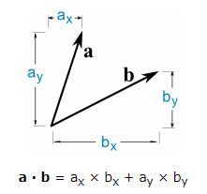
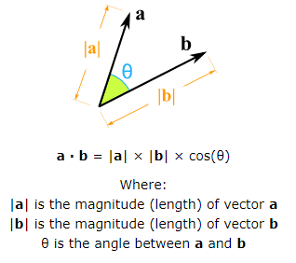
Dot product
The Dot Product gives a number as an answer (a "scalar", not a vector).
Notes:
https://www.mathsisfun.com/algebra/vectors-dot-product.html

Slide 6
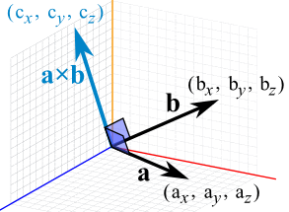

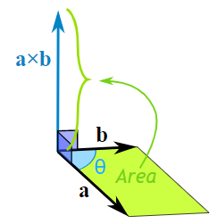
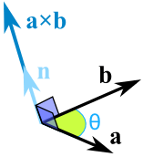
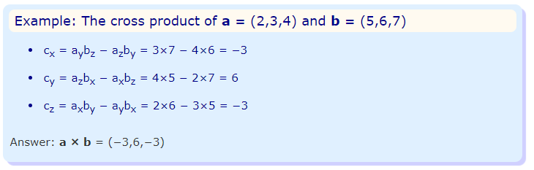
Cross product
The Cross Product a × b of two vectors is another vector that is at right angles to both, and it all happens in 3 dimensions.
n is the unit vector at right angles to both a and b.
We multiply by the vector n to make sure it heads in the right direction (at right angles to both a and b).
Notes:
https://www.mathsisfun.com/algebra/vectors-cross-product.html

Slide 7
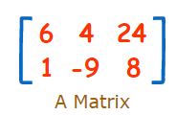
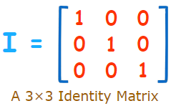

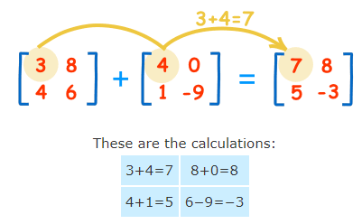
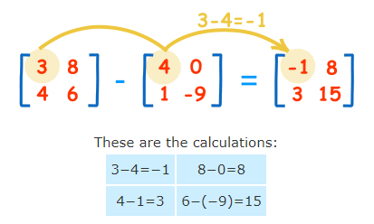
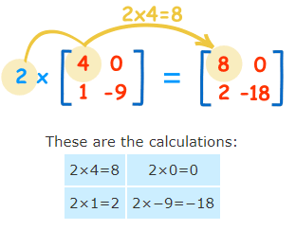
Operation
A Matrix is an array of numbers.
Special matrix: Identity Matrix
Notes:
https://www.mathsisfun.com/algebra/matrix-introduction.html

Slide 8
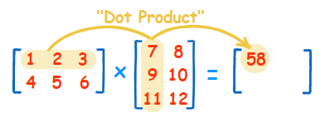


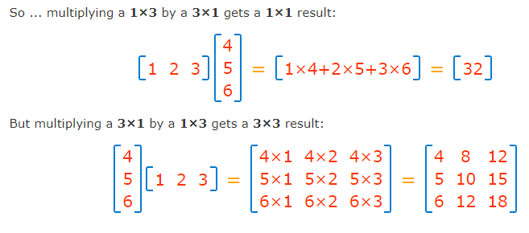
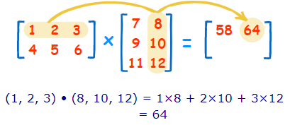
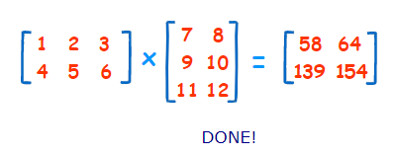
Multiplication
In General: To multiply an m×n matrix by an n×p matrix, the ns must be the same, and the result is an m×p matrix.
Notes:
https://www.mathsisfun.com/algebra/matrix-multiplying.html

Slide 9
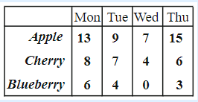
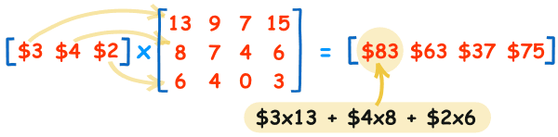
Multiplication Example
The local shop sells 3 types of pies.
Apple pies cost $3 each
Cherry pies cost $4 each
Blueberry pies cost $2 each
This how many they sold in 4 days:
The sales for Monday were:
Apple pies: $3×13=$39,
Cherry pies: $4×8=$32,
Blueberry pies: $2×6=$12.
Together that is $39 + $32 + $12 = $83
Tuesday: $3×9 + $4×7 + $2×4 = $63
Wednesday: $3×7 + $4×4 + $2×0 = $37
Thursday: $3×15 + $4×6 + $2×3 = $75
.
Notes:
https://www.mathsisfun.com/algebra/matrix-multiplying.html

Slide 10

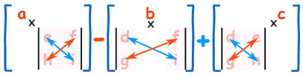

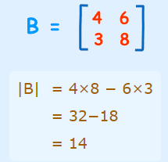
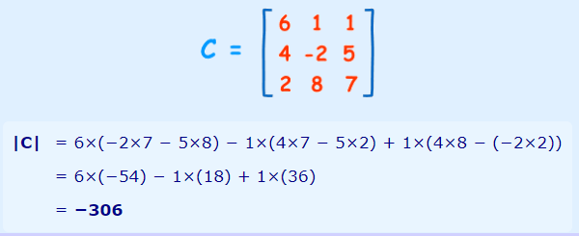

Determinate
The determinant of a matrix is a special number that can be calculated from a square matrix.
useful in systems of linear equations
helps us find the inverse of a matrix
is useful in calculus and more.
|A| = a(ei − fh) − b(di − fg) + c(dh − eg)
|A| = ad − bc
Notes:
https://www.mathsisfun.com/algebra/matrix-determinant.html

Slide 11

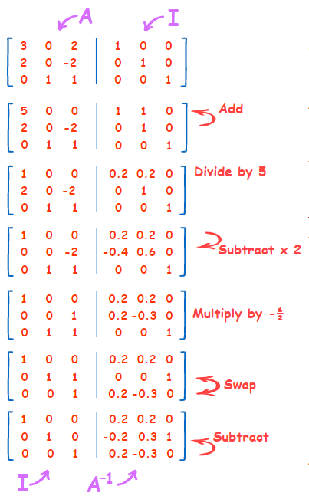
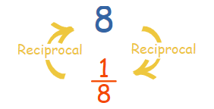
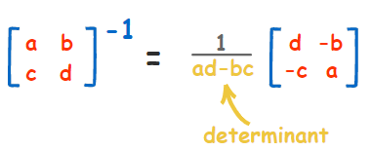
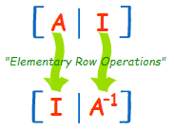
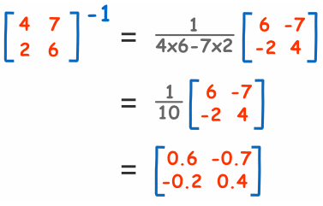
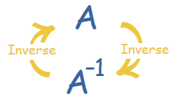

Inverse
8 × (¹/₈) = 1
A × A⁻¹ = I
Notes:
https://www.mathsisfun.com/algebra/matrix-inverse.html

Slide 12
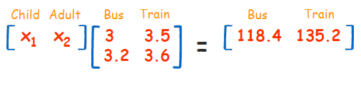
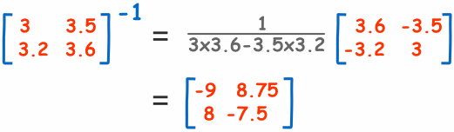
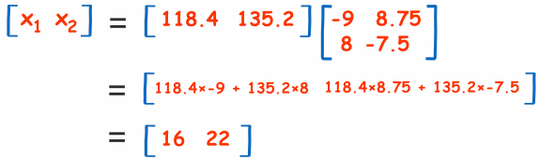
Inverse example
A group took a trip on a bus, at $3 per child and $3.20 per adult for a total of $118.40.
They took the train back at $3.50 per child and $3.60 per adult for a total of $135.20.
How many children, and how many adults?
.
Notes:
https://www.mathsisfun.com/algebra/matrix-inverse.html

Slide 13
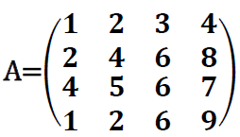
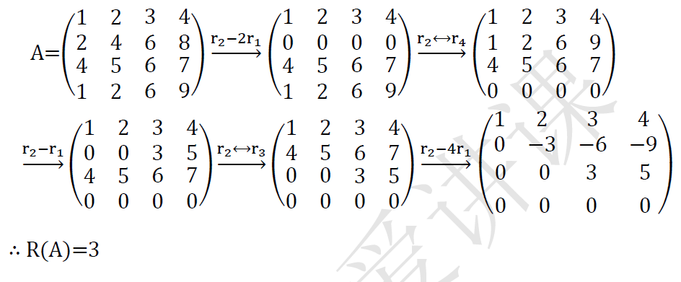
Rank
Maximum number of linearly independent rows/ columns of matrix A.
Example 1: Find the rank of the matrix A
.
Notes:
https://www.cliffsnotes.com/study-guides/algebra/linear-algebra/real-euclidean-vector-spaces/the-rank-of-a-matrix

Slide 14
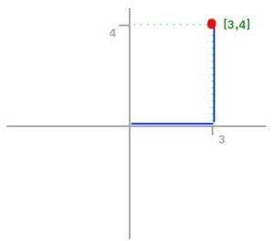

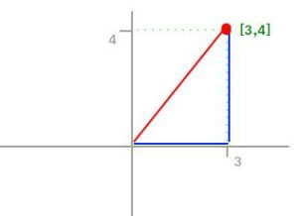

Norm
L1 Norm
L2 norm
Known as Manhattan Distance or Taxicab norm.
L1 Norm is the sum of the magnitudes of the vectors in a space.
.
Known as the Euclidean norm.
L2 is the shortest distance to go from one point to another.
Notes:
https://medium.com/@montjoile/l0-norm-l1-norm-l2-norm-l-infinity-norm-7a7d18a4f40c

Slide 15
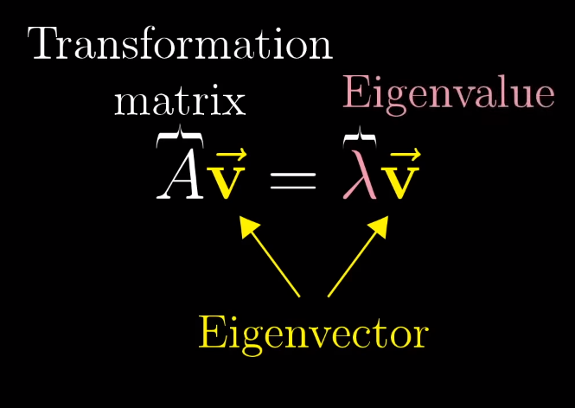
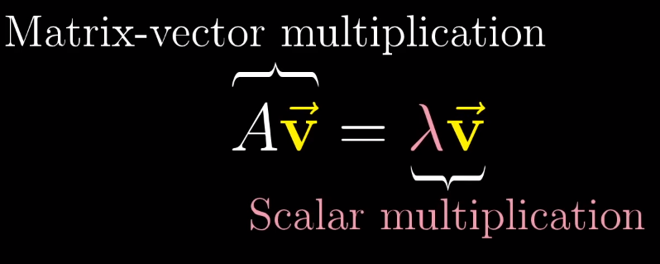
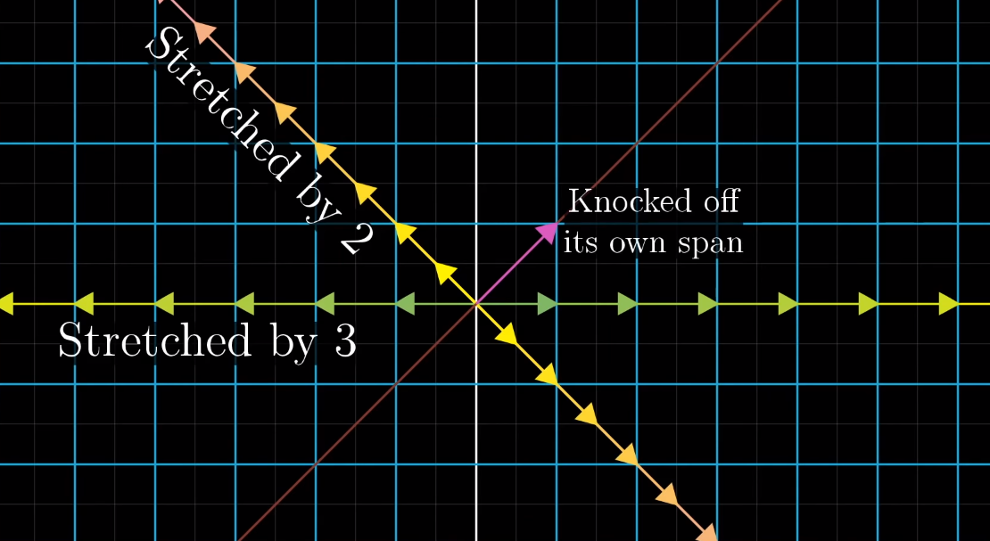
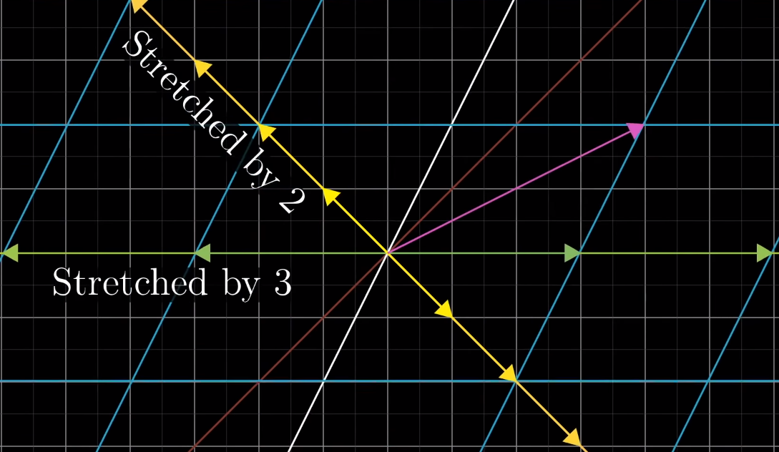
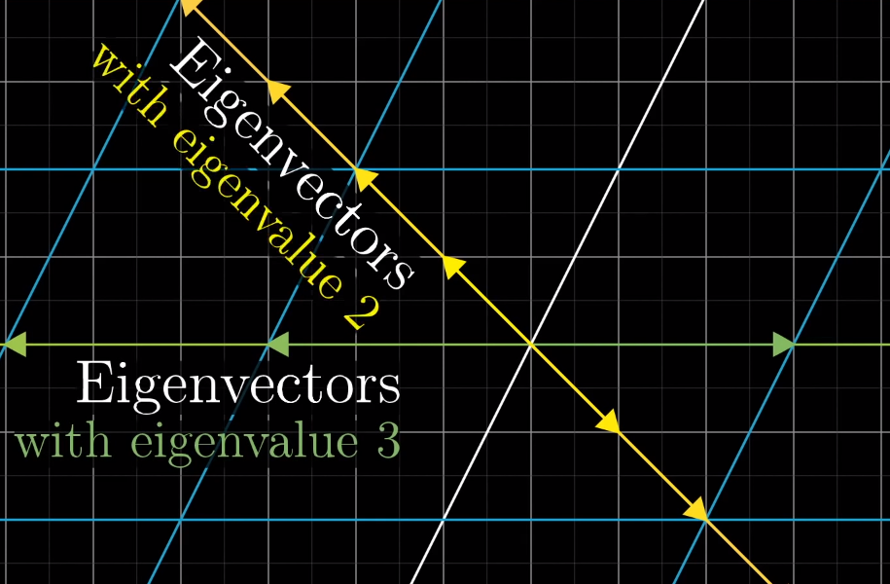
Eigenvector
Suppose that A is the standard matrix for a linear transformation T.
Then if Av = λv, it follows that T(v) = λv.
This means that if v is an eigenvector of A, then the v under the transformation T is a scalar multiple of v – and the scalar involved is the corresponding eigenvalue λ
.
Notes:
https://www.youtube.com/watch?v=PFDu9oVAE-g
http://www.math.harvard.edu/archive/20_spring_05/handouts/ch05_notes.pdf

Slide 16
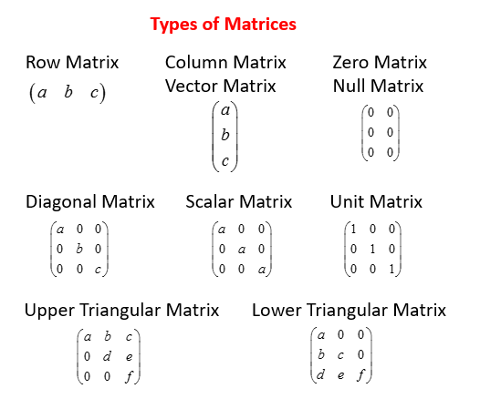
Types of Matrices

Slide 17
The End
Kuan Sao I
4th December 2019

